Slide 1
Computer networks and operating systems
project
Coordinators
Conf. Dr. prof. Luminita Scripcariu
Asst. Dr. prof Daniel Matasaru
Students
Novac Ion
Robu Marcelin

Slide 2
The Roman Catholic Episcopate of Iasi
Adress: Stefan cel Mare Bld., no.26, postal code 700064
Phone:0232 212 003
Total number of employees(for the Roman-Catholic Iasi Episcopate):~1130

Slide 3
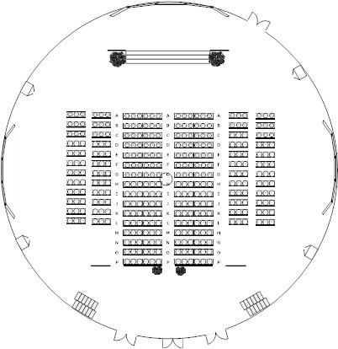
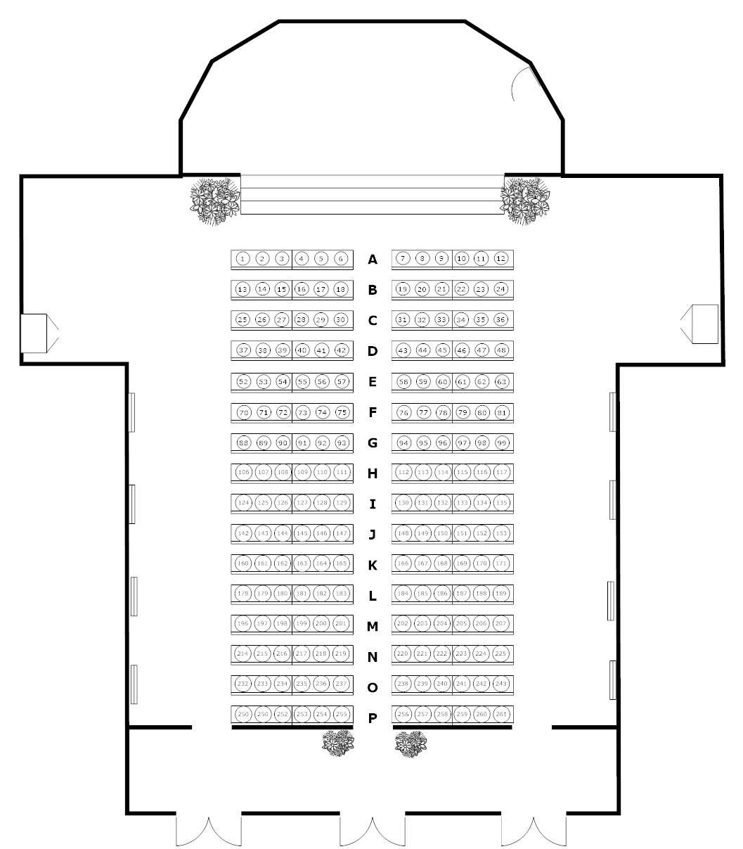
"Saint Virgin Mary, Queen" Cathedral
The Roman-Catholic Parish The Dormition of the Virgin Mary

Slide 4
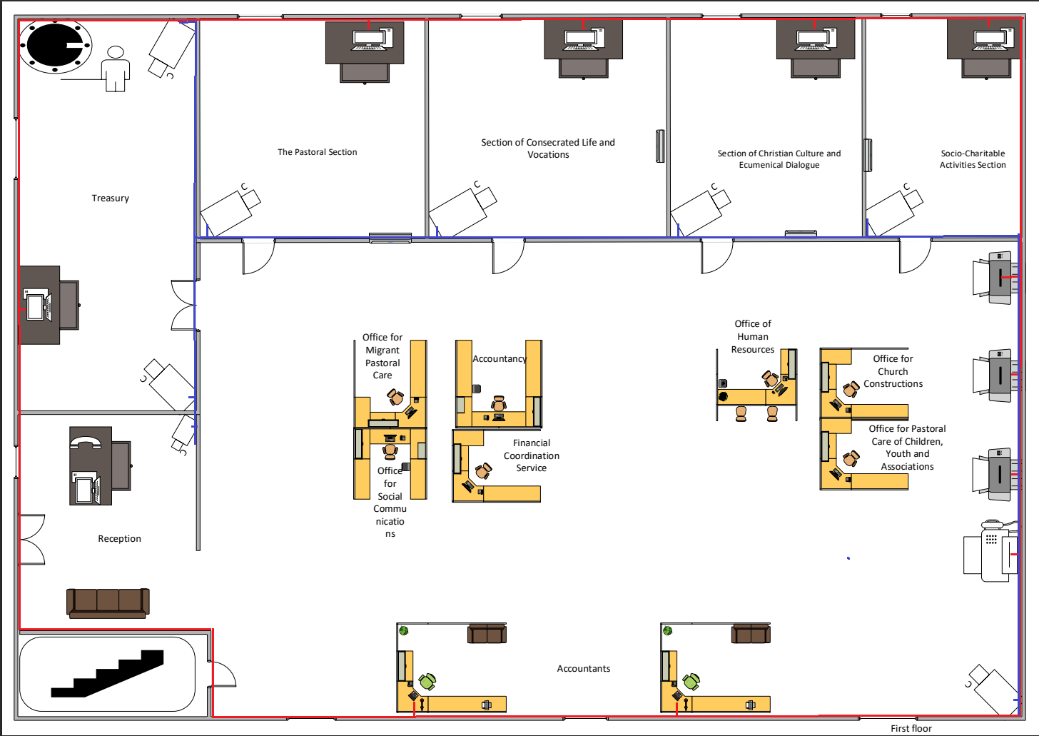
First floor

Slide 5
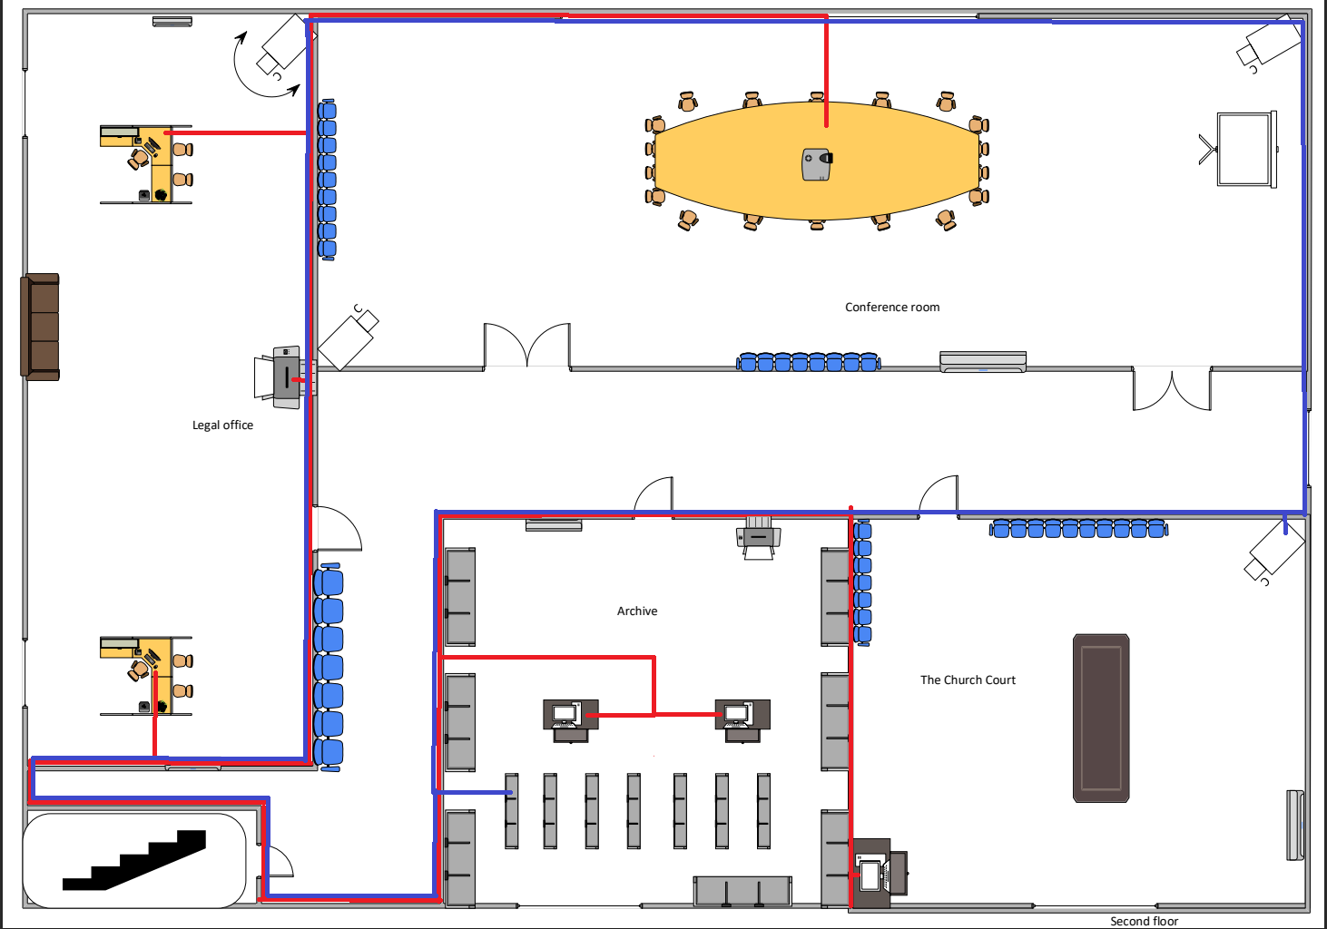
Second floor

Slide 6
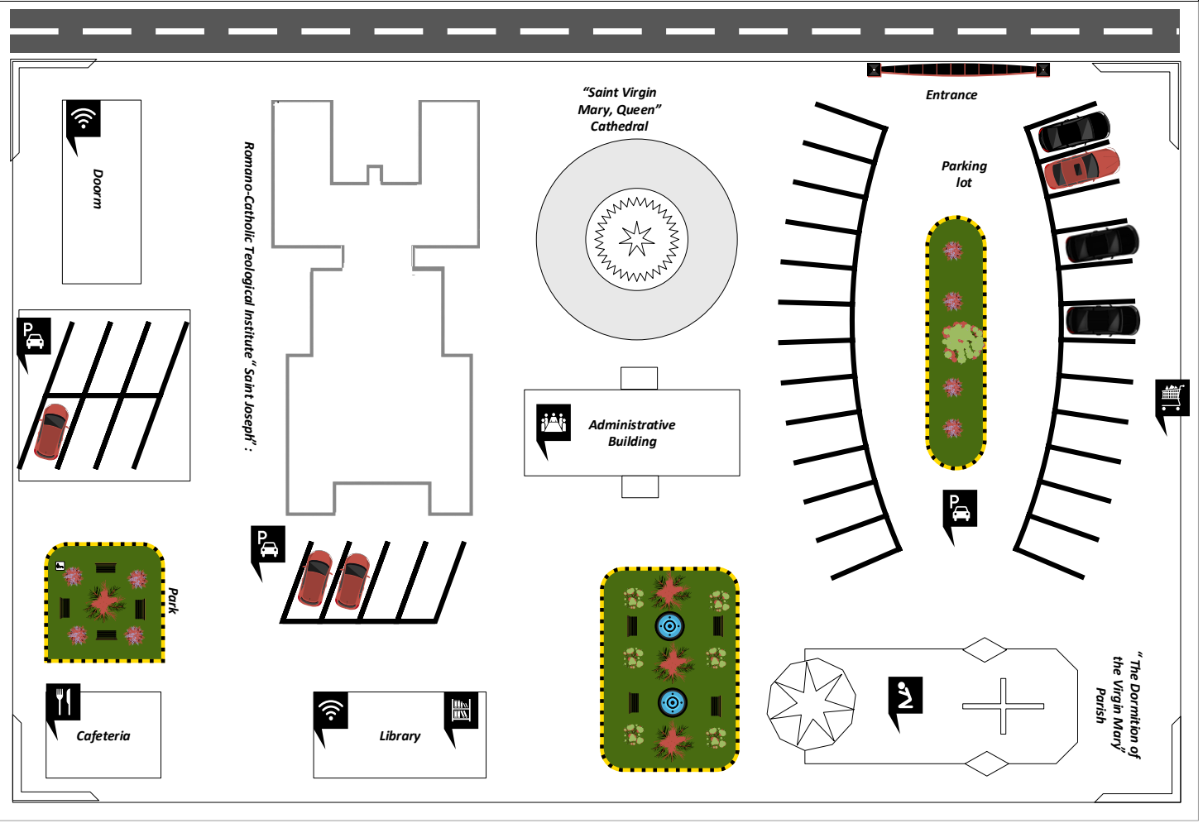
General scheme

Slide 7
Network analysis
Subnetworks necessary now: 8
Future subnetworks: 8
Number of hosts in the biggest network: 19
Number of hosts in the biggest network in the future: 25
IP class: C

Slide 8
Subnetwork # | Subnetwork ID | IP adress of subnetwork | Interval host | Broadcast adress
#0 | 000 | 192.168.79.0 | 192.168.79.1 - 192.168.79.30 | 192.168.79.31
#1 | 001 | 192.168.79.32 | 192.168.79.33 – 192.168.79.62 | 192.168.79.63
#2 | 010 | 192.168.79.64 | 192.168.79.65 – 192.168.79.94 | 192.168.79.95
#3 | 011 | 192.168.79.96 | 192.168.79.97 – 192.168.79.126 | 192.168.79.127
#4 | 100 | 192.168.79.128 | 192.168.79.129 – 192.168.79.158 | 192.168.79.159
#5 | 101 | 192.168.79.160 | 192.168.79.151 – 192.168.79.180 | 192.168.79.191
#6 | 110 | 192.168.79.192 | 192.168.79.193 - 192.168.79.222 | 192.168.79.223
#7 | 111 | 192.168.79.224 | 192.168.79.225 -192.168.79.254 | 192.168.79.255

Slide 9
Subnetworks
Adress:192.168.79.0 – C class
No. of subnetworks: 2S >= 8→ S=3 (23= 8)
No. of hosts: 2H–2 >= 25 → H=5 (25–2 = 30)
Subnet mask:255.255.255.224/27 (24+3)

Slide 10
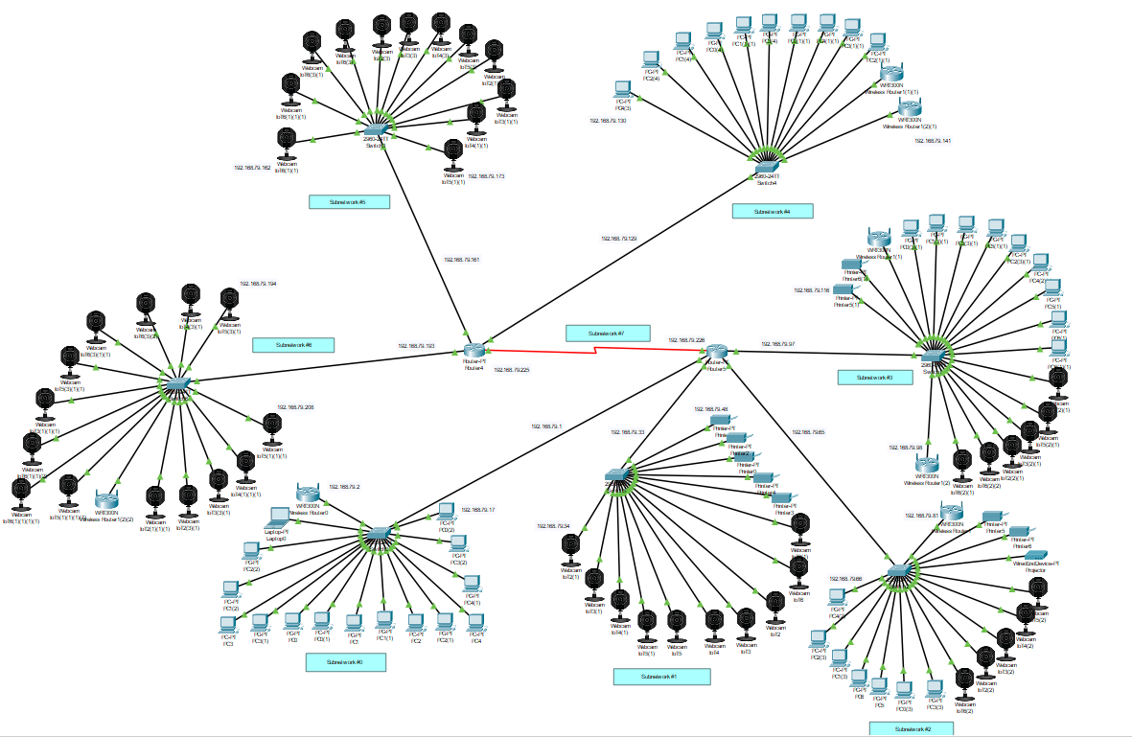
Simulation sketch

Slide 11
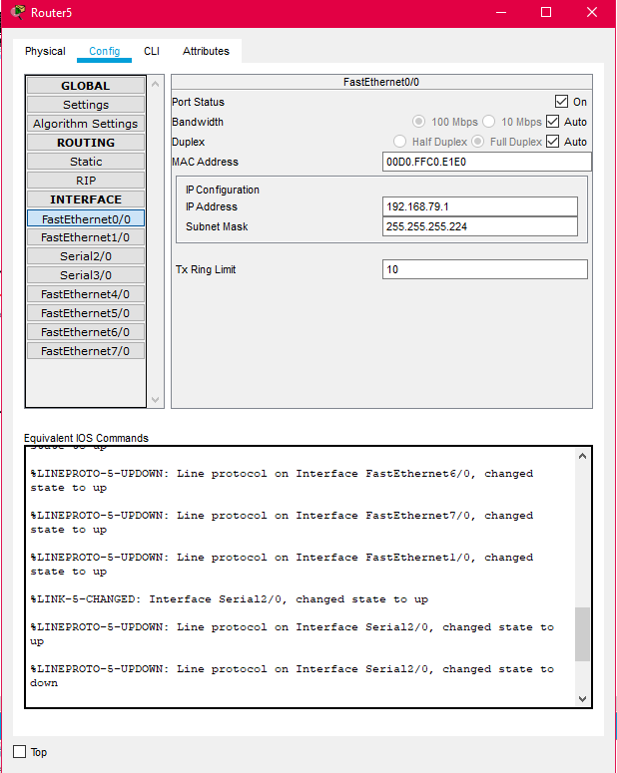
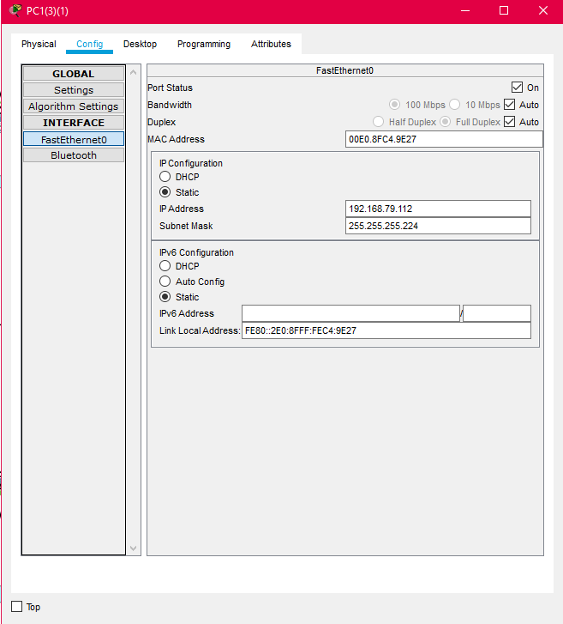

Slide 12
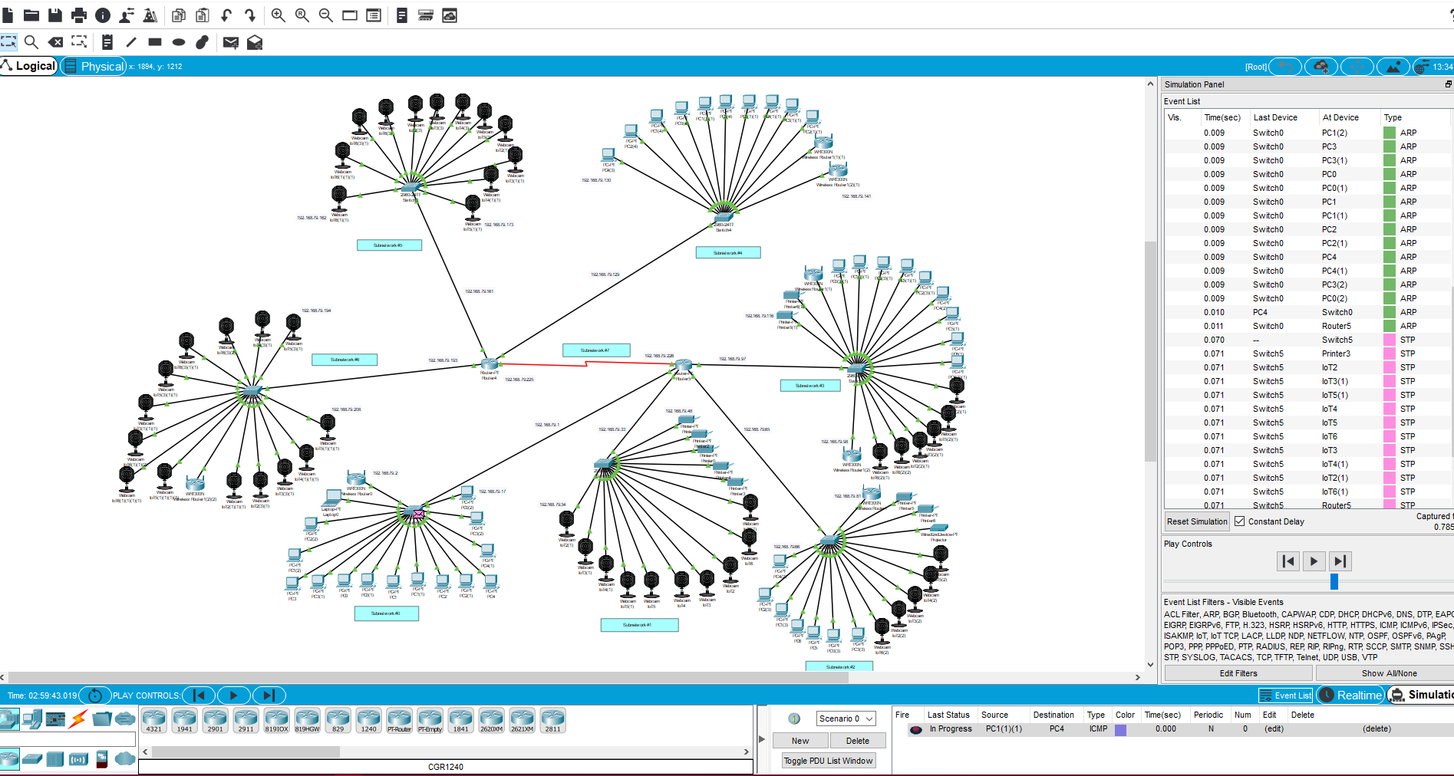

Slide 13
Project costs
Installing costs:
-estimated time for all the work:3 weeks
-employees:1 system engineer, 1 network engineer, 2 technician
-for the 3 weeks of work the wages will be:
System engineer:5118.57 lei
Network engineer:4869.29 lei
Technician:3682.86 lei*2=7365.72 lei
Accountant:3245.72 lei
Total: 17313.58 lei(for manual labour)
Human resources
Job | No. of employees | Gross wage(monthly) | CAS (25%) | Health insurance(10%) | Employment insurance(2.25%) | Net wage(monthly) | Vouchers (monthly)
System engineer | 1 | 7166 | 1752 | 701 | 158 | 4100 | 315
Network engineer | 1 | 6817 | 1667 | 667 | 150 | 3900 | 315
Technician | 2 | 5156 | 1261 | 504 | 113 | 2950 | 315

Slide 14
Materials
Equipment | No. of units | Price(RON) | Cost(RON)
NAS Synology DS218, 2-Bay SATA 3G, 1.4GHz, 2GB RAM, 1x GbE LAN, 1xUSB2.0, 2 x USB3.0 | 1 | 1.548.00/piece | 1.548.00
HDD Seagate IronWolf 12TB SATA3 7200RPM 256MB | 2 | 1.924.00/piece | 3.848.00
System Server Lenovo SR650 Xeon Silver 4110 (8C 2.1GHz 11MB Cache), 16GB RAM, O/B ( 8x2.5" SATA/SAS HS) | 1 | 11.099.00/piece | 11.099.00
Rackable Switch 48 ports 100MB TP-Link TL-SF1048 | 7 | 800/piece | 5600.00
Netgear Nighthawk X4S AC2600 WiFi Router | 7 | 1.626,97/piece | 11,388.79
CISCO1803 Integrated Services Router 1803/K9. Wireless LAN features: OFDM, CCK, QPSK, BPSK, DBPSK, DQPSK, 16QAM, 64QAM, DSSS. DSL features: ADSL. Data transmission: 0.1 Gbit/s. Network: wired. Pro | 2 | 724,36 /piece | 1,448.72
Kit supraveghere video complet cu 4 camere interior 5MP Safer, Dvr DAHUA | 6 | 1.398.92/piece | 8,393.52
Bullet camera IP Wireless Hikvision DS-2CD2041G1-IDW1, 4MP, 2.8mm, microphone, card slot, IR 30m, IP66 | 2 | 270/piece | 540
4 cameras exterior metal 5 MP, IR 60 metri cu DVR Dahua 4K | 4 | 1.400.95/piece | 5603.8
Wireless exterior camera DIGICAM | 2 | 620.00/piece | 1240.00
UTP cable Cat6 Rola 500 meters SCHRAC | 1 | 860.00/piece | 860.00
UPS 1500VA cu stabilizer (AVR) CyberPower UT1500E, 4 sockets schuko | 1 | 490.00/piece | 490.00
100 piece jack CAT. 6 STP | 3 | 92.61/piece | 277.83
PVC cable channel with adhesive tape, 25x16 mm | 500 meters | 1.7/meter | 850

Slide 15
Logistics
Equipment | Quantity | Price(RON) | Cost(RON)
Dacia Dokker | 1 | 321.91/day | 6.760,28
network TESTER UTP, STP, USB, GEMBIRD NCT-2 | 5 | 57.2 | 286
Drill machine Bosch Easy Impact 550, 550 W, 3000 RPM, 33.000 percussions/min, 11 Nm | 2 | 304/piece | 608
Self-adjusting crimping pliers for end pins | 2 | 125/piece | 250
Cutter 18mm TOPEX | 2 | 8.6/piece | 17.2
Universal patent pliers 240mm, tip E | 2 | 45/piece | 90
Bosch - X-Line - Set 15 mixed drills, 3-8 mm, cylindrical rod, wood, metal, stone | 1 | 20/piece | 20
Aluminium ladder | 1 | 416/piece | 416
Total costs
Equipment | 53187.66
Logistics | 8447.48
Indirect expenses | 7,378.6
Manual labour | 17313.58
Profit(20%) | 15575.96
Taxes(16%) | 2492.15
Total cost | 104,395.43lei

